Slide 1

Real World Problems?

Slide 2



AHHH!
QUEUE
MY REACTION

Slide 3


Smart Cart

Slide 4
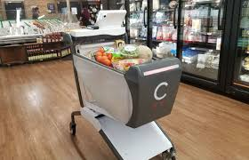
AI Powered “CAPER”

Slide 5
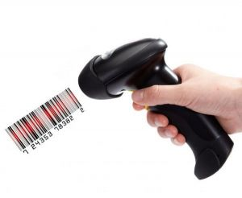
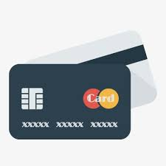
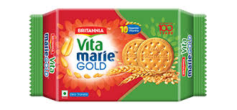
Diagram for Currently used version of caper
Scan with OnCart Barcode Reader
Pay & Go.
Take the product

Slide 6
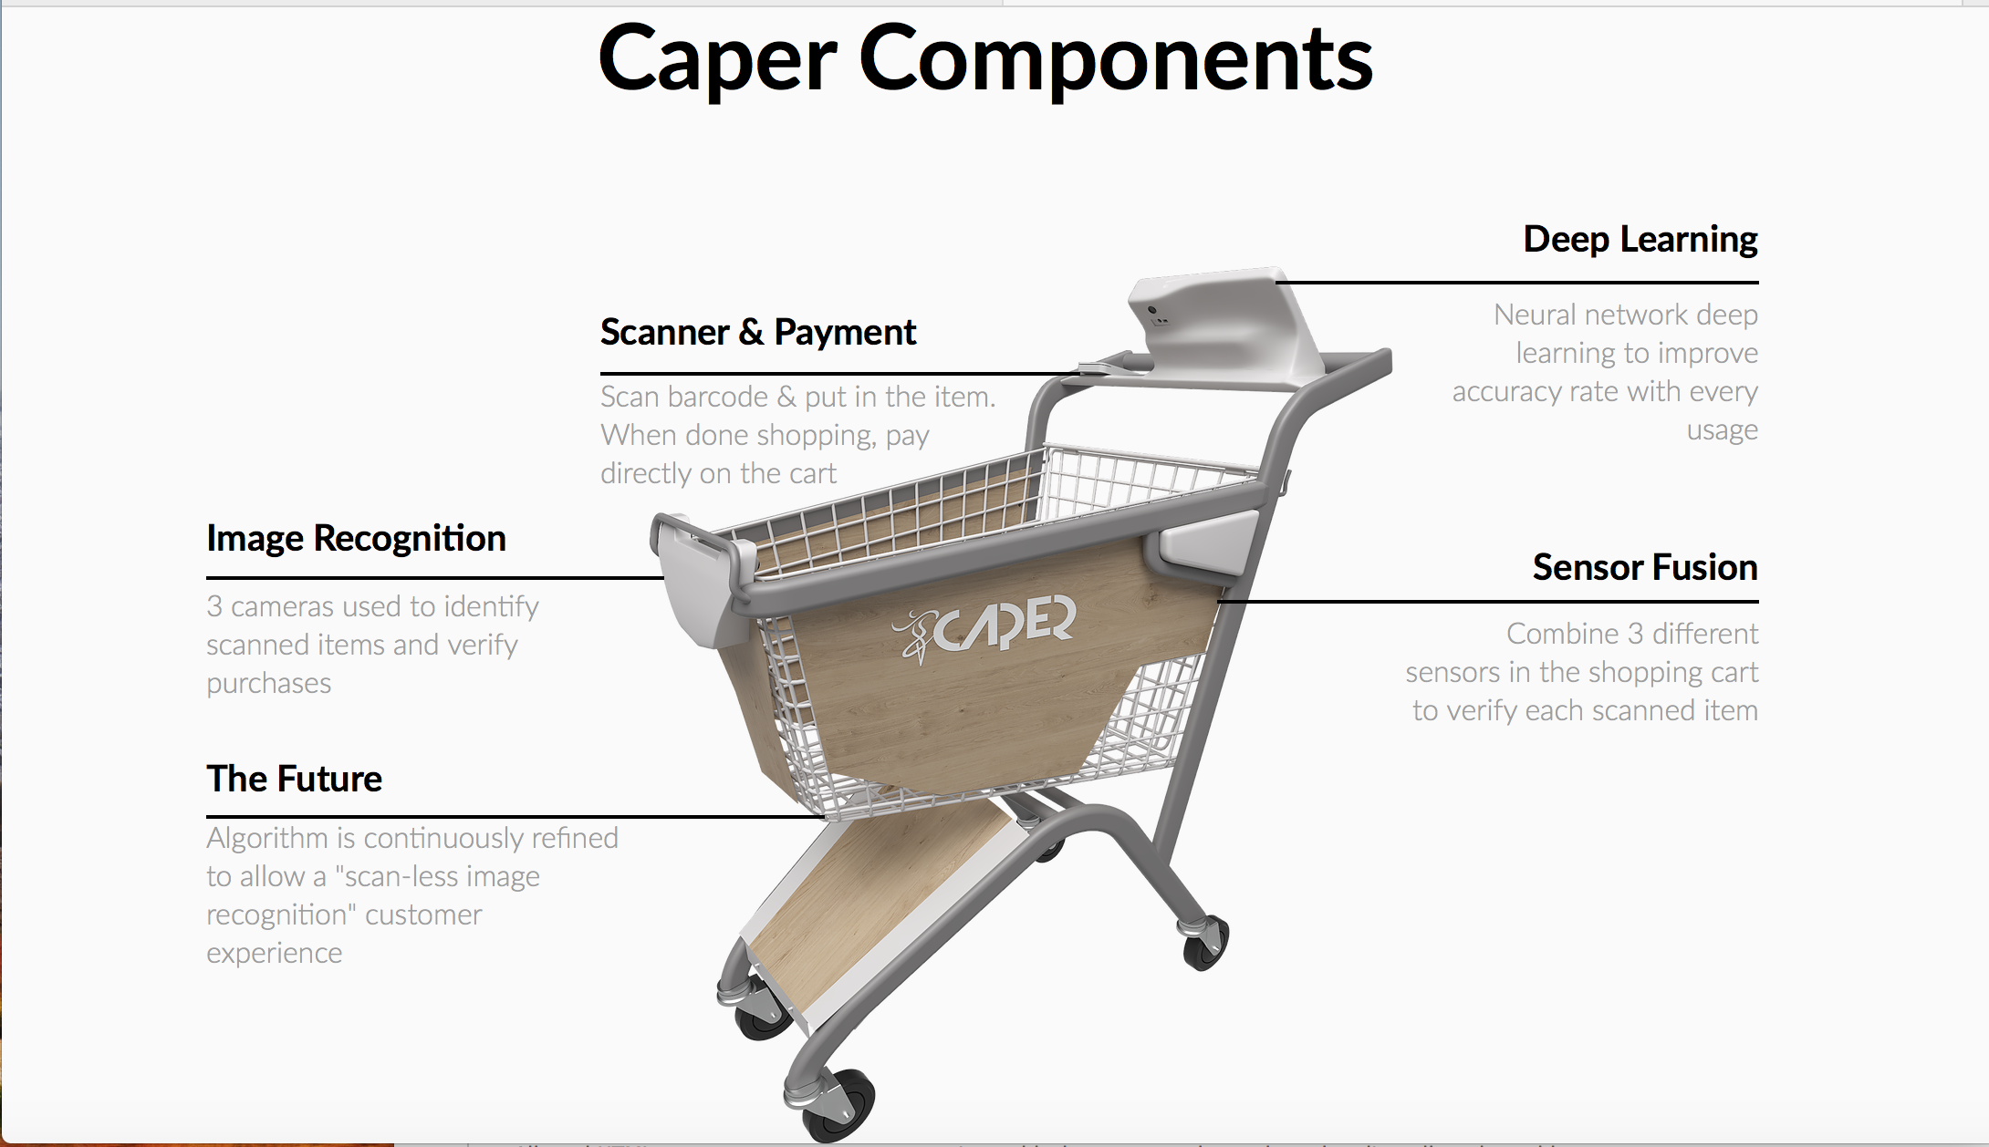
https://www.youtube.com/watch?time_continue=1&v=2_c-9vJi4b0

Slide 7

Applications
Grocery Stores.
Malls
Production Departments
And Many More

Slide 8

Advantages
Saves Your Time.
No need to stand in Queue.
No need for malls to keep cashier’s.
No scanning , just drop your things onto the cart.
Hassle free payment directly onto the cart.

Slide 9

Disadvantage
Nothing from the end user’s customers point of view.
Costly for the shops and mall chains.

Slide 10


Thank You Every One For Your Valuable Time.
Any Questions?

